Slide 1
CAMELYON 16
COMS 4995 – Applied Deep Learning (Spring 2019)
Final Presentation
Members - Luv Agrawal, Sagar Negi, Saurabh Runwal

Slide 2
Overview
Goal is to evaluate new and existing algorithms for automated detection of metastases in hematoxylin and eosin (H&E) stained whole-slide images of lymph node sections
Task has high clinical relevance but requires large amounts of reading time from pathologists
A successful solution would hold great promise to reduce the workload of the pathologists while at the same time reduce the subjectivity in diagnosis.

Slide 3
Project: Develop tool to assist Physicians
Scope – Detect Cancer in Gigapixel Pathology images
Data – Consists of whole-slide images (WSI) of hematoxylin and eosin (H&E) stained lymph node sections.
Ground truth annotations were carefully prepared under supervision of expert pathologists
Use Deep Learning to build models that can accurately predict the tumorous region given an Whole Slide Image

Slide 4
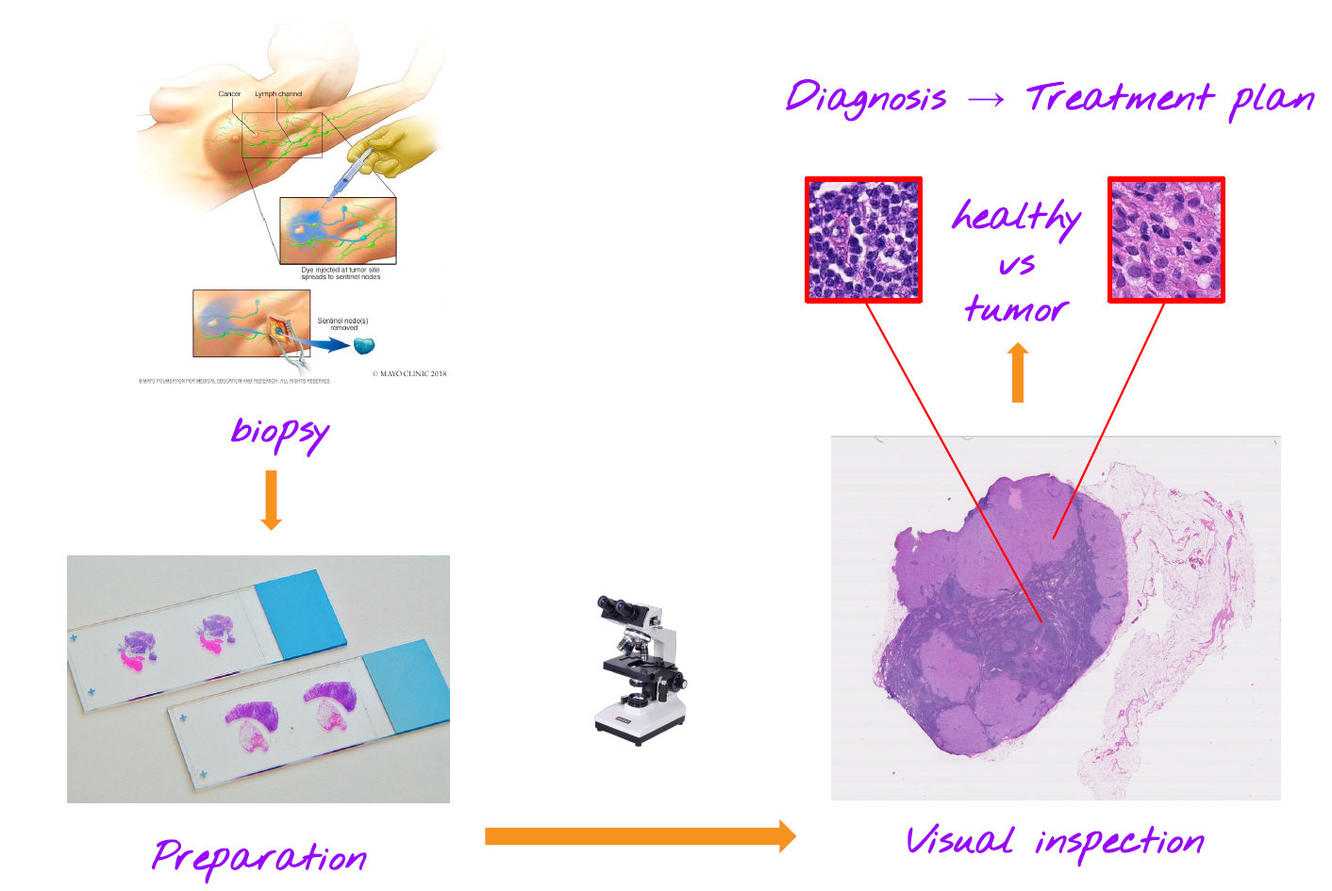

Slide 5
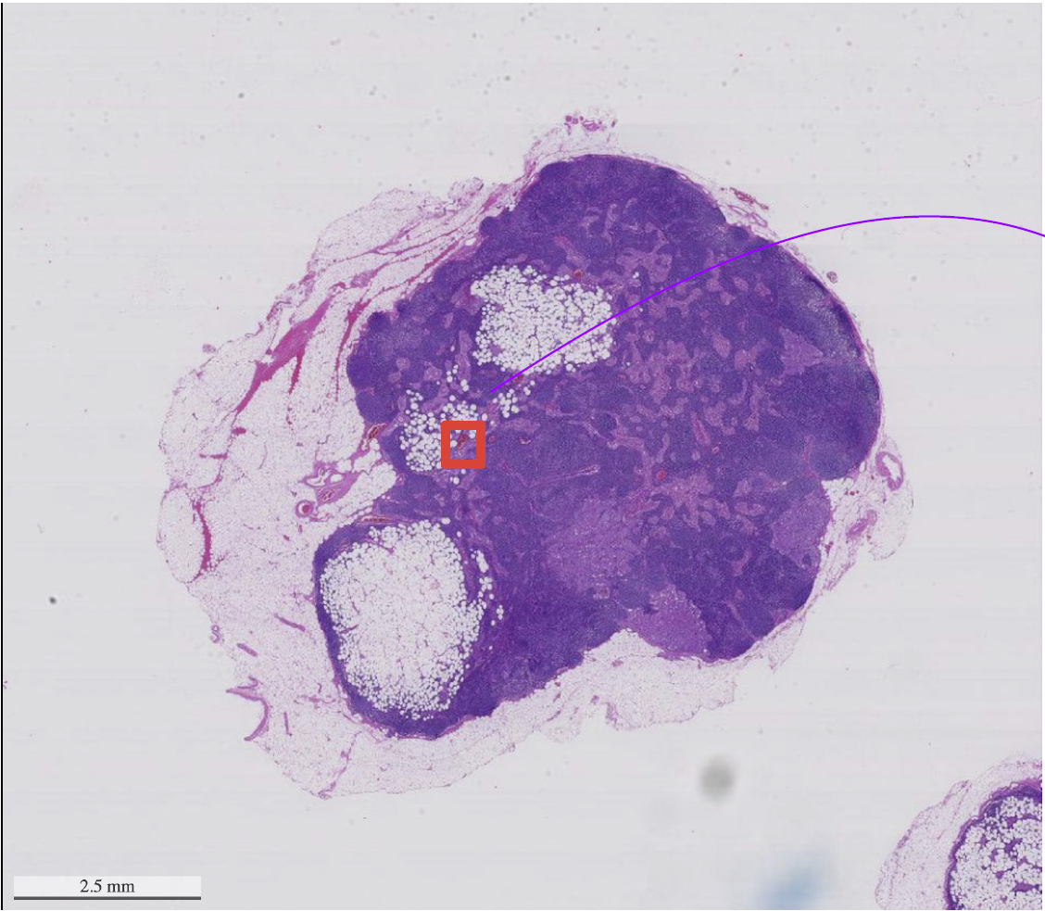
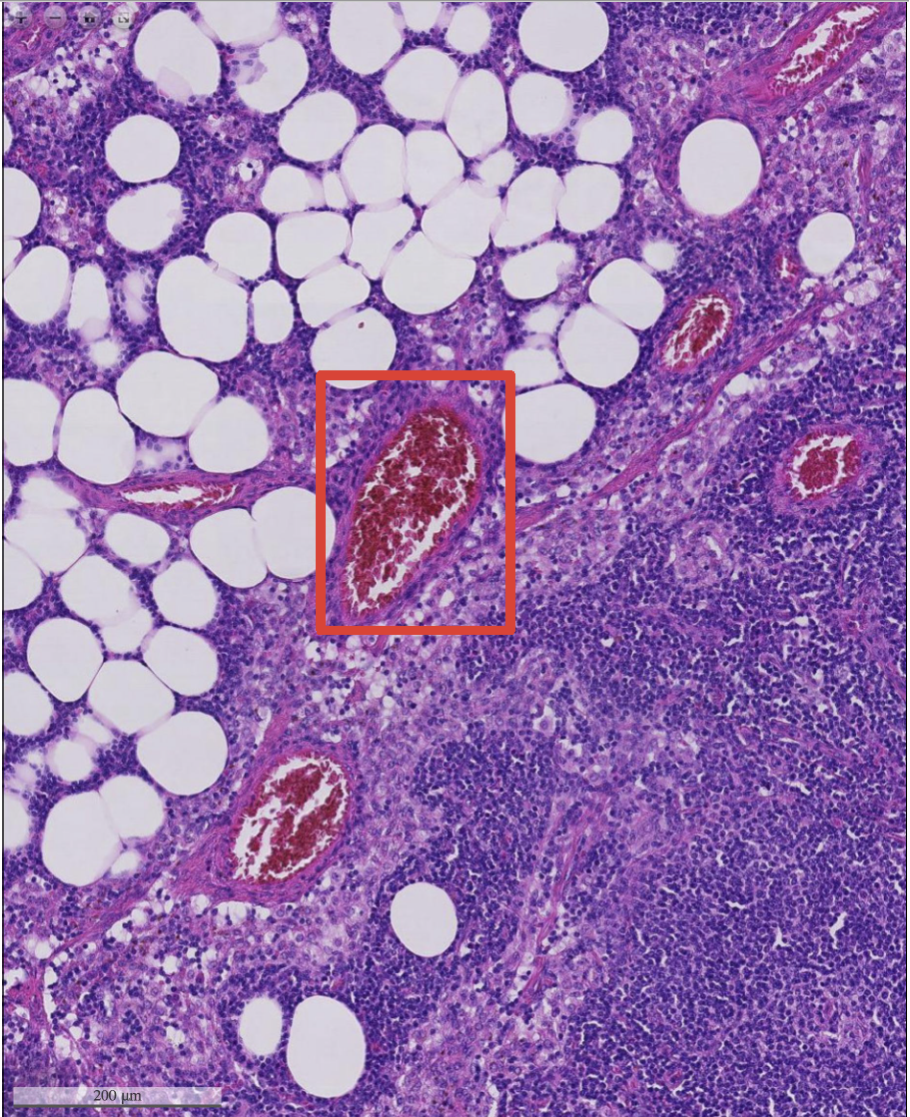
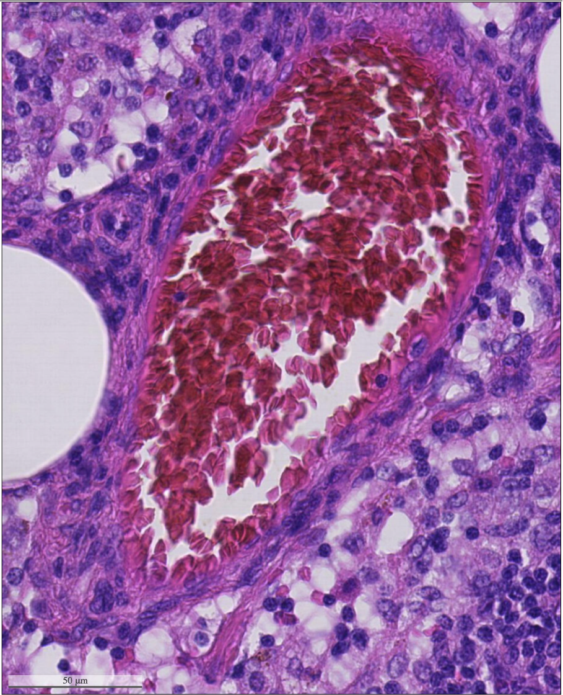
WSI – Whole Slide Image
Image with 7 zoom levels captures different magnifications of the slide
Mask images annotated by physicians available for training

Slide 6
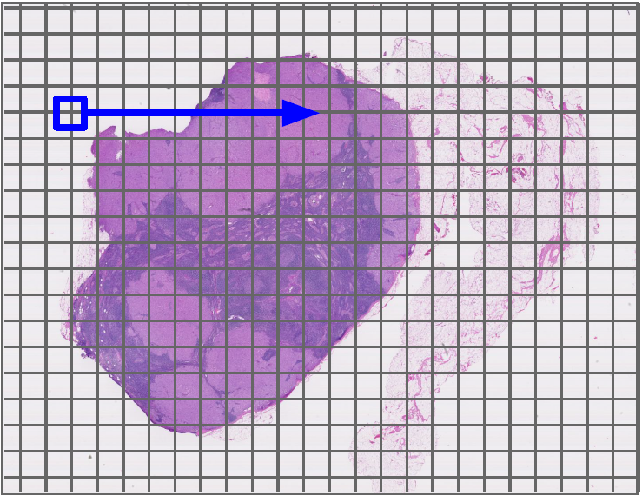
Methodology
Extract multiple slices of the WSI on different zoom levels
Train a model on each zoom level
Generate heatmap (logits) of predictions on each zoom level
Generate a weighted aggregate heatmap combining heatmaps across different zoom levels
Compare the heatmap with the truth value and produce metrics

Slide 7
Data Extraction
Split the 25 available slides into
15 training
5 validation
5 testing
Extract multiple 299x299 pixels slices from the WSI for each zoom level
Label the patch as cancerous if it has even a single cancerous cell
Initially stored the data as arrays in single file, but soon ran out of memory on Lower levels
Later stored images on google drive (no memory issues) and inbuilt support for data augmentation
Use adaptive stride based on the zoom level
Ignore slices that contain less tissue percentage

Slide 8
Dealing with Imbalanced Dataset
Extreme imbalance due to the nature of the dataset
Our initial models gave high accuracy but poor F1 scores
Balancing the dataset –
Slicing only in the Region of Interest (reduces the negative samples)
Undersampling the negative samples
Label the patch as cancerous if it has even a single cancerous cell

Slide 9
Using Data Augmentation
The training, validation and testing slides could consist of image with any orientation
Thus it is mandatory to use data augmentation to accurately predict on the testing slices
Use Tensorflow’s inbuilt ImageDataGenerator to produce different augmentations based on :
Rotation
Width Shift
Height Shift
Horizontal flip
Vertical flip
No Zoom in or out was used since we train model on multiple zoon levels

Slide 10
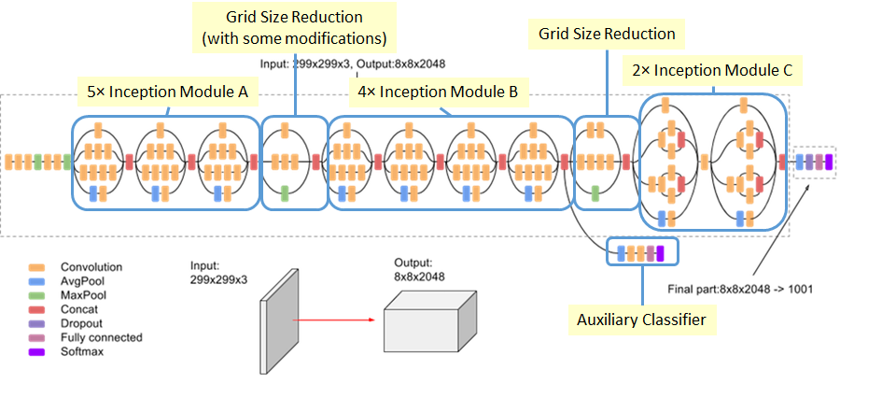
Model Demystified
Started out with a Deep CNN based model
Online research suggested using InceptionV3 proved to give better accuracies
Experimented with Custom Ensemble, Resnet, VGG16 and InceptionV3 and decided to move forward with InceptionV3
Rationale –
Better F1 scores on 2 levels tested
Faster convergence
Online study suggested Inception was
great for this use case

Slide 11
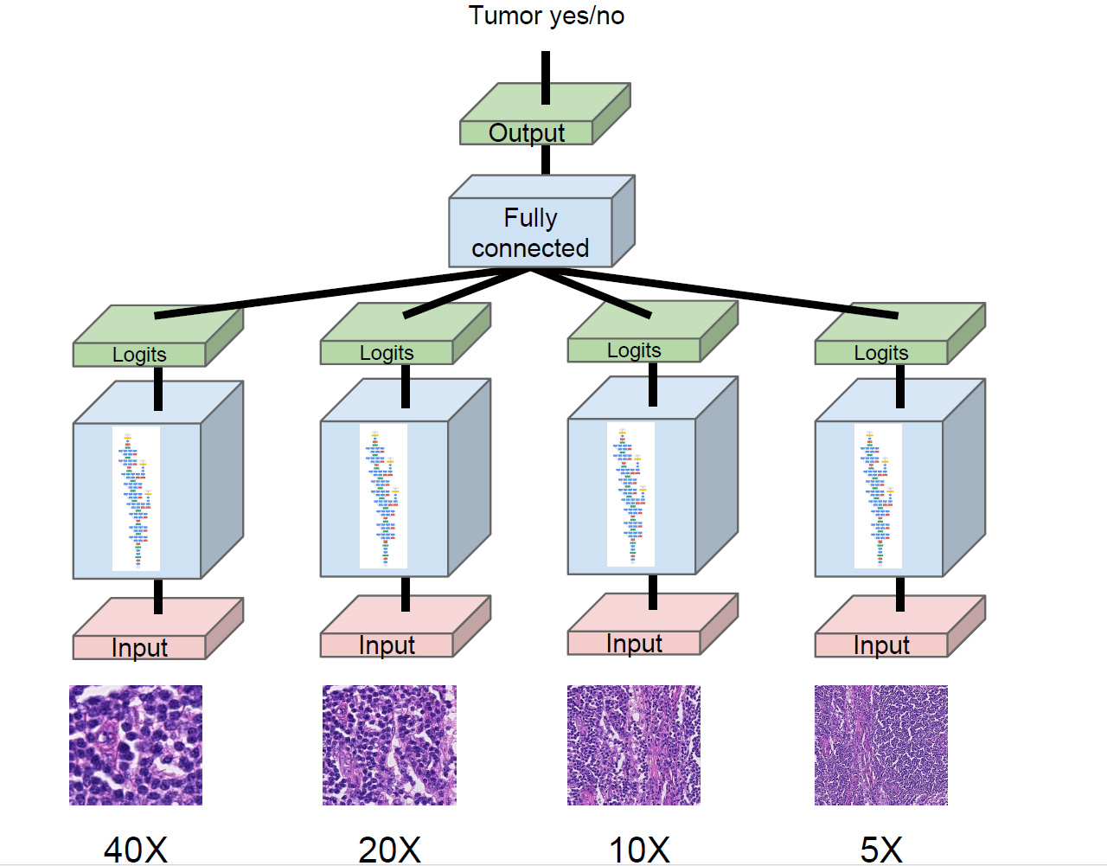
Heatmap
Level 1
Level 3
Level 4
Level 6

Slide 12
Metrics used for tracking Model
Accuracy and Loss
To test the convergence of the model
Trained on 10 epochs and check if the loss stabilized
Confusion Matrix
Giving us good insight into the “true” performance
Was important in figuring out we need to undersample the data
Precision/Recall and F1 scores
ROC Curves (for heatmaps)

Slide 13
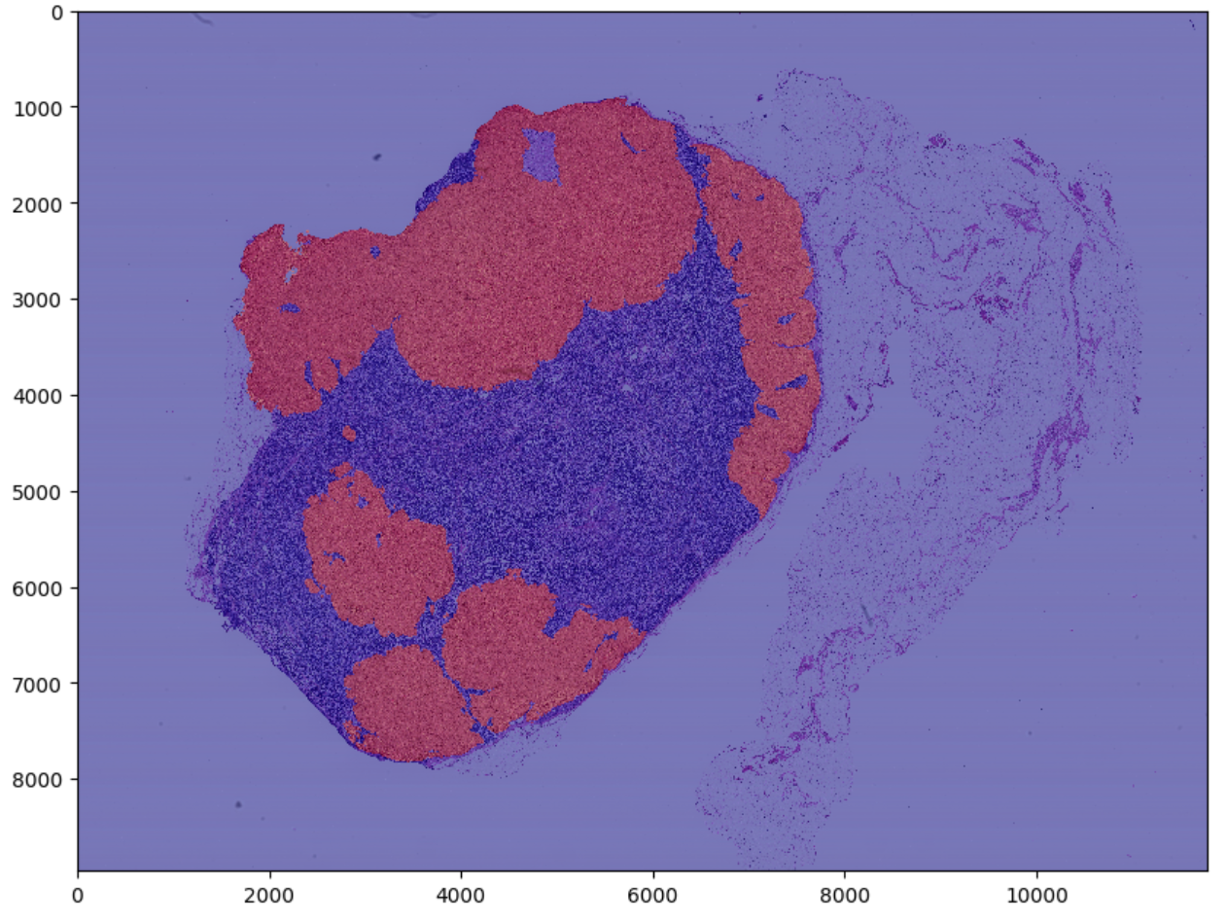
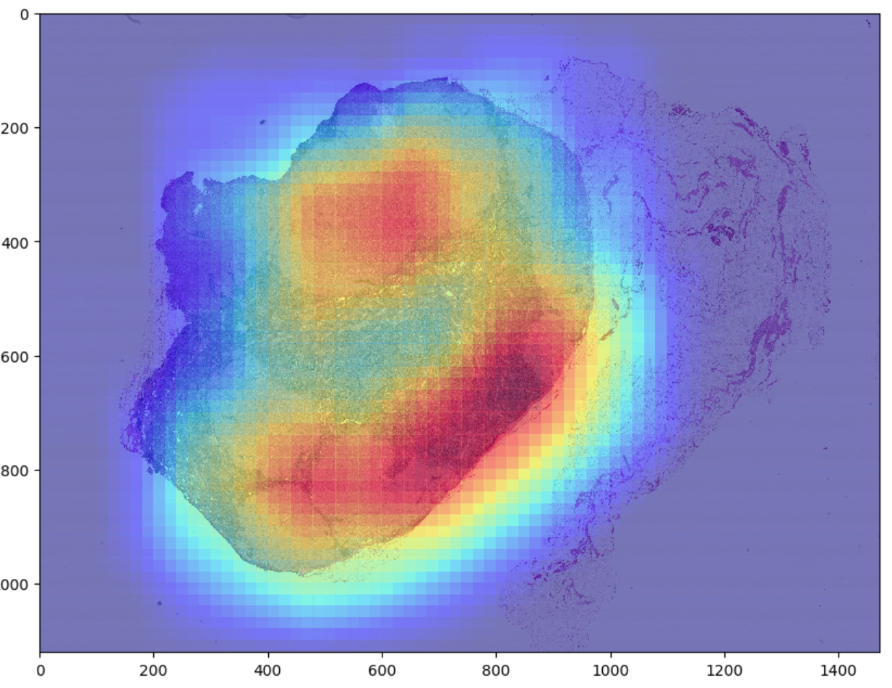
Generating Heatmap
Use the Test Image to generate Heatmaps by iterating over the image with a very small stride
For consistency we ignore samples with less than 30% tissue percentage
For remaining samples we run predictions on the them and produce heatmap
This is done for every level that the models were trained on (in our case level 1, 3, 4, 5, 6)
A sample heatmap is shown in the image

Slide 14
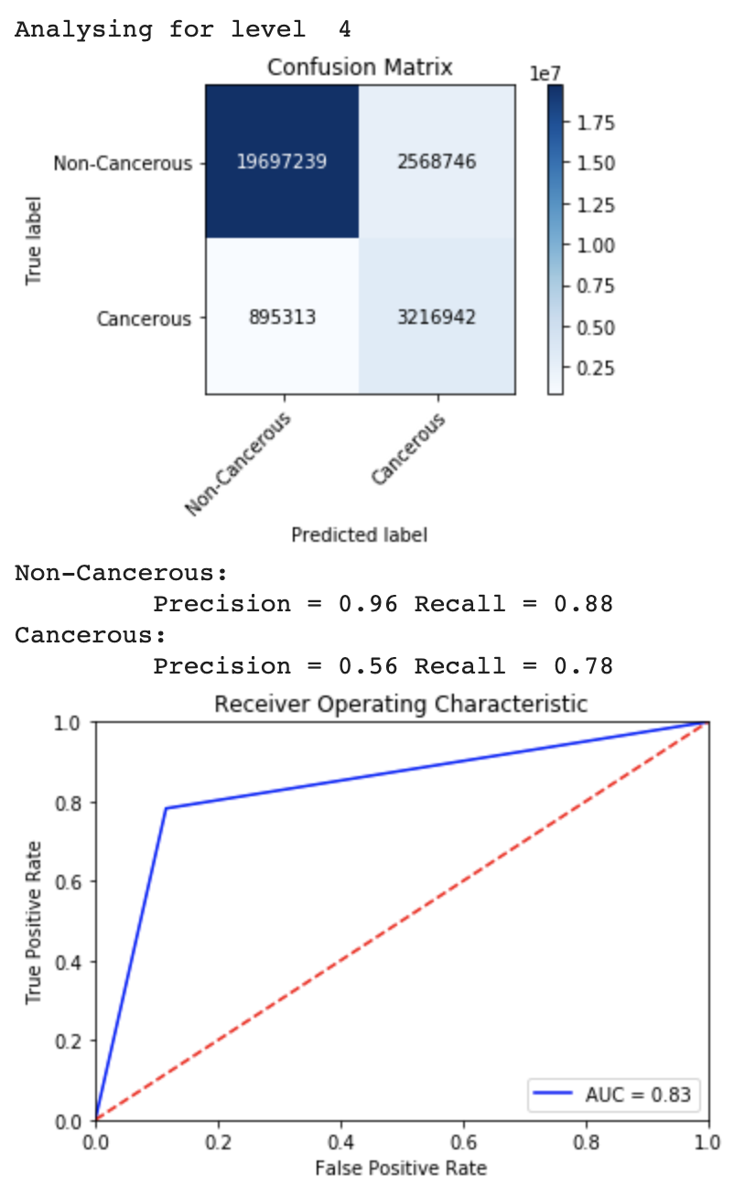
Heatmap Analysis
For every level we compare the predicted heatmap with the truth value as given by the mask image
By thresholding the heatmap on an appropriate value (supplied as a hyperparamter) we compare various metrics
Confusion Matrix / Precision / Recall
ROC Curve

Slide 15
Combing Heatmaps
Once we have heatmaps for different levels we use image processing to threshold the heatmap
We then combine the heatmaps to output the final true value as predicted by the model
The combination weights across levels are chosen to minimize the loss
The true value for the heatmap is considered to be that of the lowest level in the mask image
We again produce metrics on merged heatmap as an additional parameter to test our model

Slide 16
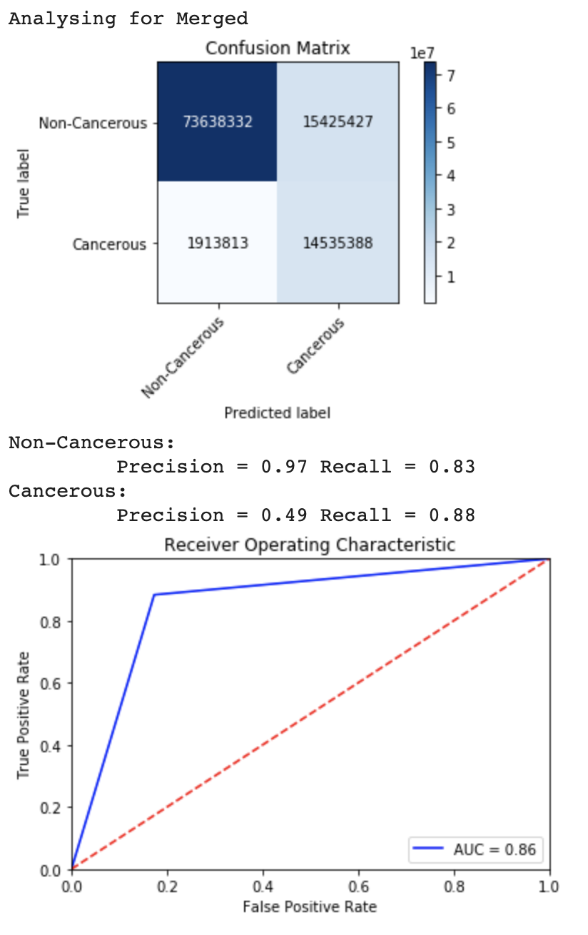
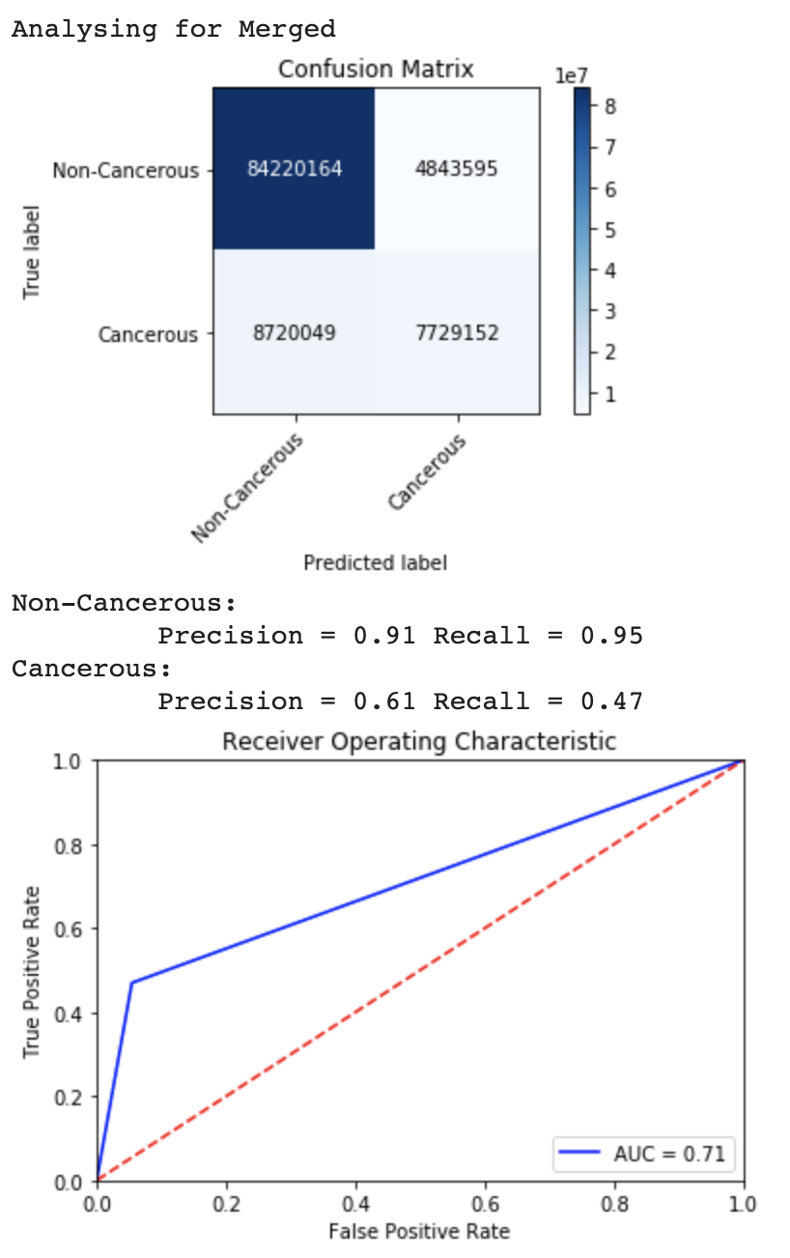

Thresholding Value

Slide 17
Conclusion
We present a model to successfully classify the cancerous and non-cancerous patched from Whole Slide images
Trained on multiple zoom levels our model is robust and gives reasonable good results with the limited training data

Slide 18
Challenges Faced
Lack of Domain Expertise
Imbalanced dataset
Low F1 scores on initial models
Running out of memory and long training times
Choosing metrics
Loss and Accuracy are poor metrics
Problems with Model Convergence

Slide 19
Future Work and Recommendations
Train the model on more number of training samples to get a better representation of the real world data
Explore the use of LSTM/GRU layer that takes a sequence of logits representing different levels
Assist not Replace

Slide 20
Code Walkthrough

